Slide 1
Computer Networks _22CS008
Network Security
Lecture 15-16 (Theory)
Dr. Dinesh Vij
Department of Computer Science and Engineering,
Chitkara University, Punjab

Slide 2
INDEX
Security Services
Security Threats
Security Vulnerabilities
Physical Security

Slide 3
Security Services
Network security includes five services:
Four of these services are related to message exchanged using the network:
Message confidentiality
Integrity
Authentication
Nonrepudiation
The fifth service provides entity authentication or identification.

Slide 4
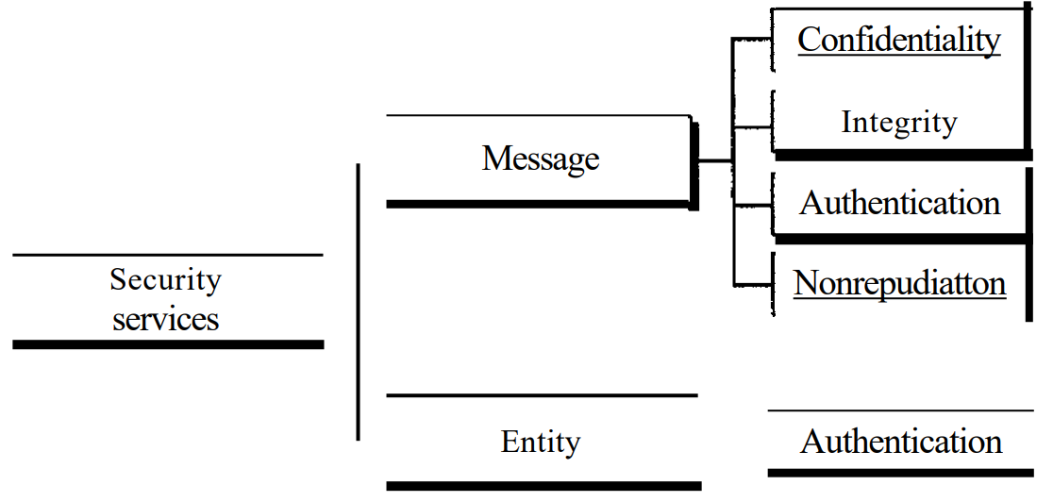
Security Services
Fig. 1 Security Services

Slide 5
Security Services
Message Confidentiality:
Message confidentiality or privacy means that the sender and the receiver expect confidentiality.
The transmitted message must make sense to only the intended receiver.
To all others, the message must be garbage.
When a customer communicates with her bank, she expects that the communication is totally confidential.

Slide 6
Security Services
Message Integrity:
Message integrity means that the data must arrive at the receiver exactly as they were sent.
There must be no changes during the transmission, neither accidentally nor maliciously.
As more and more monetary exchanges occur over the Internet, integrity is crucial.
For example, it would be disastrous if a request for transferring $100 changed to a request for $10,000 or $100,000. The integrity of the message must be preserved in a secure communication.

Slide 7
Security Services
Message Authentication:
Message authentication is a service beyond message integrity.
In message authentication the receiver needs to be sure of the sender's identity and that an imposter has not sent the message.
Message Nonrepudiation:
Message nonrepudiation means that a sender must not be able to deny sending a message that he or she, in fact, did send.
The burden of proof falls on the receiver.
For example, when a customer sends a message to transfer money from one account to another, the bank must have proof that the customer actually requested this transaction.

Slide 8
Security Services
Entity Authentication:
In entity authentication (or user identification) the entity or user is verified prior to access to the system resources (files, for example).
For example, a student who needs to access her university resources needs to be authenticated during the logging process. This is to protect the interests of the university and the student.

Slide 9
Types of Threats
Wired and wireless computer networks are essential to everyday activities. Individuals and organizations depend on their computers and networks. Intrusion by an unauthorized person can result in costly network outages and loss of work.
Attacks on a network can be devastating and can result in a loss of time and money due to damage, or theft of important information or assets.
Intruders can gain access to a network through software vulnerabilities, hardware attacks, or through guessing someone's username and password. Intruders who gain access by modifying software or exploiting software vulnerabilities are called threat actors.
After the threat actor gains access to the network, four types of threats may arise.

Slide 10

Information theft
Information theft is breaking into a computer to obtain confidential information.
Information can be used or sold for various purposes such as when someone is stealing proprietary information of an organization, like research and development data.
The figure shows an open folder
Fig. 2 Information Theft

Slide 11
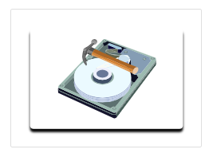
Data loss and manipulation
Data loss and manipulation is breaking into a computer to destroy or alter data records. An example of data loss is a threat actor sending a virus that reformats a computer hard drive.
An example of data manipulation is breaking into a records system to change information, such as the price of an item.
Fig. 3 Data loss and manipulation

Slide 12
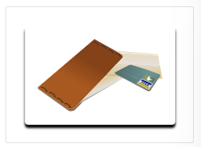
Identity theft
Identity theft is a form of information theft where personal information is stolen for the purpose of taking over the identity of someone.
Using this information, a threat actor can obtain legal documents, apply for credit, and make unauthorized online purchases. Identify theft is a growing problem costing billions of dollars per year.
Fig. 4 Identity theft

Slide 13
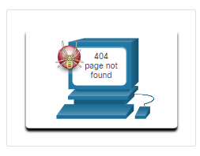
Disruption of service
Disruption of service is preventing legitimate users from accessing services to which they are entitled.
Examples include denial of service (DoS) attacks on servers, network devices, or network communications links.
Fig. 5 Disruption of service

Slide 14
Types of Vulnerabilities
Vulnerability is the degree of weakness in a network or a device. Some degree of vulnerability is inherent in routers, switches, desktops, servers, and even security devices.
Typically, the network devices under attack are the endpoints, such as servers and desktop computers.
There are three primary vulnerabilities or weaknesses: technological, configuration, and security policy.
All three of these sources of vulnerabilities can leave a network or device open to various attacks, including malicious code attacks and network attacks.

Slide 15
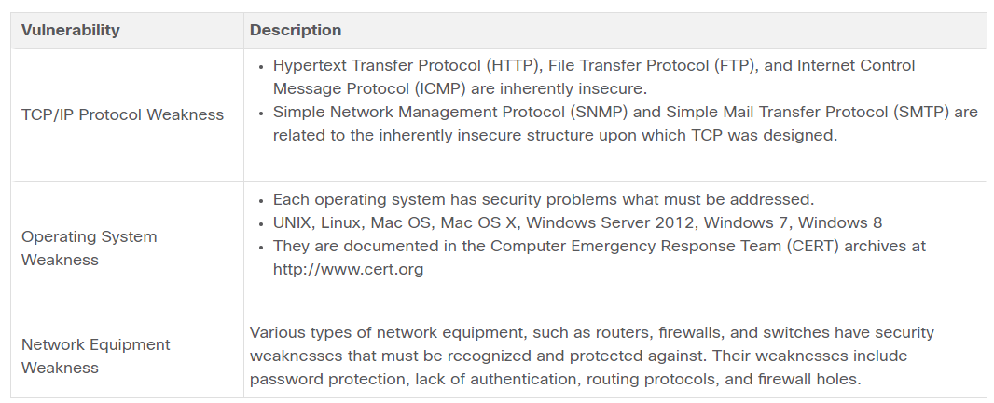
Technological Vulnerabilities

Slide 16
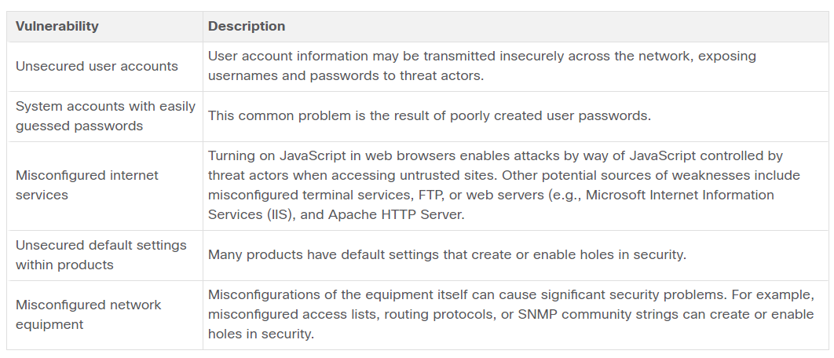
Configuration Vulnerabilities

Slide 17
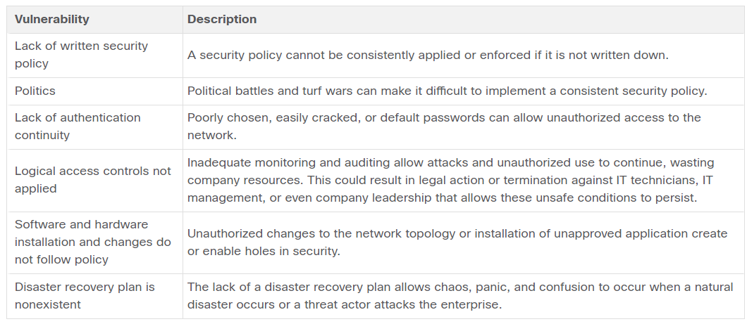
Policy Vulnerabilities

Slide 18
Physical Security
An equally important vulnerable area of the network to consider is the physical security of devices. If network resources can be physically compromised, a threat actor can deny the use of network resources.
The four classes of physical threats are as follows:
Hardware threats - This includes physical damage to servers, routers, switches, cabling plant, and workstations.
Environmental threats - This includes temperature extremes (too hot or too cold) or humidity extremes (too wet or too dry).
Electrical threats - This includes voltage spikes, insufficient supply voltage (brownouts), unconditioned power (noise), and total power loss.
Maintenance threats - This includes poor handling of key electrical components (electrostatic discharge), lack of critical spare parts, poor cabling, and poor labeling.
A good plan for physical security must be created and implemented to address these issues. The figure shows an example of physical security plan.

Slide 19
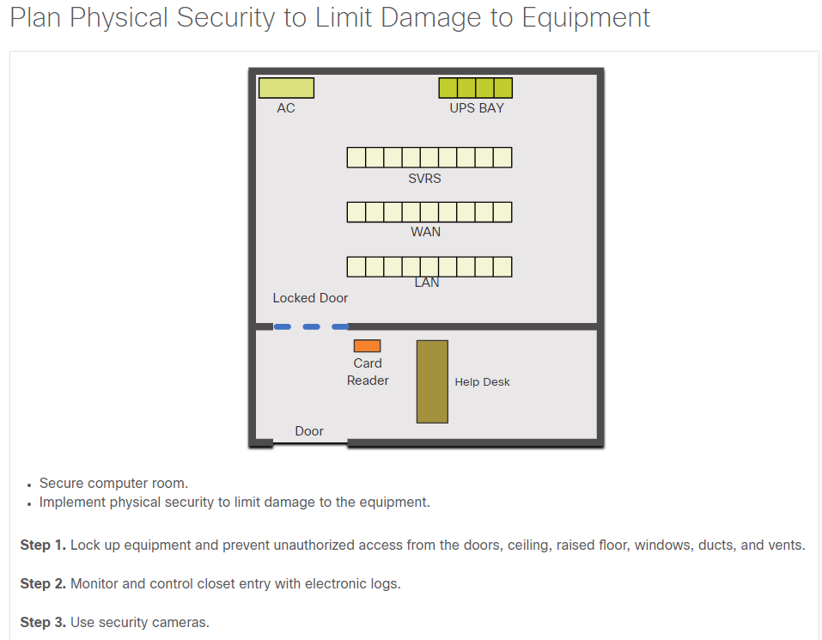
Physical Security
Fig. 6 Physical Security

Slide 20
Q & A
1) What kind of threat is described when a threat actor sends you a virus that can reformat your hard drive?
Data loss or manipulation
Disruption of service
Identity theft
Information theft
Answer: (a)
2) What kind of threat is described when a threat actor makes illegal online purchases using stolen credit information?
Data loss or manipulation
Disruption of service
Identity theft
Information theft
Answer: (c)

Slide 21
Q & A
3) What kind of threat is described when a threat actor prevents legal users from accessing data services?
Data loss or manipulation
Disruption of service
Identity theft
Information theft
Answer: (b)
4) What kind of threat is described when a threat actor steals scientific research data?
Data loss or manipulation
Disruption of service
Identity theft
Information theft
Answer: (d)

Slide 22
Q & A
5) What kind of threat is described when a threat actor overloads a network to deny other users network access?
Data loss or manipulation
Disruption of service
Identity theft
Information theft
Answer: (b)
6) What kind of threat is described when a threat actor alters data records?
Data loss or manipulation
Disruption of service
Identity theft
Information theft
Answer: (a)

Slide 23
Q & A
7) What kind of threat is described when a threat actor is stealing the user database of a company?
Data loss or manipulation
Disruption of service
Identity theft
Information theft
Answer: (d)
8) What kind of threat is described when a threat actor impersonates another person to obtain credit information about that person?
Data loss or manipulation
Disruption of service
Identity theft
Information theft
Answer: (c)

Slide 24
References
https://lms.netacad.com/course/view.php?id=2260561
https://contenthub.netacad.com/itn-dl/16.1.1

